Slide 1

Provide Support Services
CHCCCS031 - Provide individualised support (Release 1)

Slide 2

2.1 Provide Support According to the Person’s Plan, Preferences and Strengths, and Policies and Procedures

Slide 3


It is vital that you provide the support as indicated in the individualised plan.
The individualised plan:
Will already have the information of what support must be provided to the client
Defines who will assist the client and what aid or equipment they will need during the support activity
Before you can provide personal support to clients, you must first ask for their consent.
Provide Support Services

Slide 4
Who Can Give Consent
Client
This is the principal person who will be giving consent.
Support Team
Substitute decision-making is when a legally appointed person makes decisions on behalf of the client if the client is unable to give consent.
Provide Support Services

Slide 5
How to Seek Consent
When seeking consent from the client or their support team, make sure that all aspects of consent are fulfilled.
Consent must be:
Voluntary
Informed
Specific
Current
Provide Support Services

Slide 6
Providing Support According to Legal and Ethical Considerations
Reflected within legal considerations are ethical practices rooted in human beliefs of right and wrong. Examples of legal and ethical considerations relating to providing support to clients are:
Disability Act 2006
Aged Care Act 1997
Work Health and Safety Act 2011
Provide Support Services

Slide 7
Providing Personal Support According to the Individualised Plan
Support services are provided to assist the person receiving support in their activities of daily living (ADLs). These can include activities for self-care tasks at home, such as:
Showering and bathing
Oral care
Toileting
Eating and drinking
Bed bathing
Grooming
Provide Support Services

Slide 8
Support services also support clients in instances of mobility and transferring during these daily living activities, such as:
Using slide sheets, hoists, slings and lifters
Transferring a person between a bed and chair
Transferring a person from seated to standing
Transferring a person in and out of car.
Provide Support Services

Slide 9
The table below provides specific examples of manual handling techniques used for assisting with each ADL:
ADL | Manual handling technique
Showering and bathing | Using lifting and supporting techniques to help the client in getting in and out of the shower or bath
Bed bathing | Rolling the client or supporting their limbs to help with turning and repositioning
Provide Support Services

Slide 10
The table below provides specific examples of manual handling techniques used for assisting with each ADL:
ADL | Manual handling technique
Oral care | Supporting the client’s head and neck to maintain proper posture when brushing their teeth
Toileting | Using transferring techniques and mechanical aids to transfer client to and from the toilet
Provide Support Services

Slide 11
The table below provides specific examples of manual handling techniques used for assisting with each ADL:
ADL | Manual handling technique
Grooming | Providing steady support to help client in sitting or standing
Eating and drinking | Providing support to help maintaining upright position
Provide Support Services

Slide 12
Implementation of manual handling techniques should be in accordance with person-centred care (PAC). This can be done by:
Taking into account the client’s preferences, needs and goals
Including the client in the decision-making process
Recognising the client’s choice
Seeking the client’s consent
Maintaining their privacy and dignity
Provide Support Services

Slide 13

Information regarding how the client wants to be supported during ADLs can be found within their individualised plan.
Make sure to check the plan prior to providing support during these activities.
If there is no information within the plan, take the time to discuss with the client their preferences.
Provide Support Services

Slide 14
2.1.1 Showering and Bathing
Good hygiene is essential for a person’s health and sense of wellbeing.
In individualised support, providing assistance in this area allows care workers the opportunity to inspect their clients for sores, wounds or rashes.
As a care worker, you must provide clients with assistance during a bath or shower to allow them to stay safe, as you will be able to mitigate the risk of slips and falls in the bathroom.
Creating a safe bathroom environment is vital in making a positive experience for you and your clients.
Provide Support Services

Slide 15
You may consider the following procedure when assisting a client during a shower or bath:
1. Gather needed materials.
2. Prepare for the shower or bath.
3. Help the client with the shower or bath.
Provide Support Services

Slide 16
2.1.2 Bed Bathing
If bathing becomes difficult, bed baths may be done to maintain their hygiene.
Doing bed baths means bathing a person who is confined to bed.
Aside from maintaining hygiene, bed bathing helps ease some of the discomfort associated with prolonged immobility for clients.
Provide Support Services

Slide 17
Prepare for the Bath
Consider the following procedure to prepare for the bed bath:
1. Gather necessary materials.
2. Ensure doors are closed, and curtains/blinds are drawn.
3. Make sure the room’s temperature is comfortable for the client.
4. Prep the space, materials and personnel for the bed bath.
Provide Support Services

Slide 18
During the Bed Bath
When giving clients a bed bath, consider the process below:
Have the client lie on their back, with their legs slightly separated and arms loosely by their side.
Encourage the client to undress as much as they can. Refer to Section 2.1.5 for further discussion.
Cover the client with a single sheet to maintain their privacy.
Provide Support Services

Slide 19
When giving clients a bed bath, consider the process below:
Encourage the client to wash as much as they can by themself. Assist them as they do so by finishing any incomplete areas for them. In some cases, clients are able to wash themselves or some parts of their bodies adequately without help.
Wash the face, neck and armpits with the washcloth. Then, wash their chest, stomach and limbs one at a time. Pay attention to skin folds and between fingers and toes. Pat each washed body part dry with a towel as you go.
Provide Support Services

Slide 20
When giving clients a bed bath, consider the process below:
Roll the client onto their side to wash and dry the back surfaces of their body.
Offer a bedpan or urinal. Refer to Section 2.1.4 for further discussion.
Wash the private areas of the client last. You may consider changing the water prior to this process to ensure that the water used is clean.
Make sure that you are not taking too long with the bath. The client may end up feeling fatigued or chilled.
Provide Support Services

Slide 21
2.1.3 Oral Care
Maintaining personal hygiene also involves taking care of one’s oral hygiene.
One of the most common diseases affecting children and adults is tooth decay.
A person can lower the risk of tooth decay by:
Limiting sugar consumption
Regular toothbrushing
Cleaning between the teeth with floss or interdental brushes
Regularly having teeth checked by a dentist or other oral health professional
Provide Support Services

Slide 22
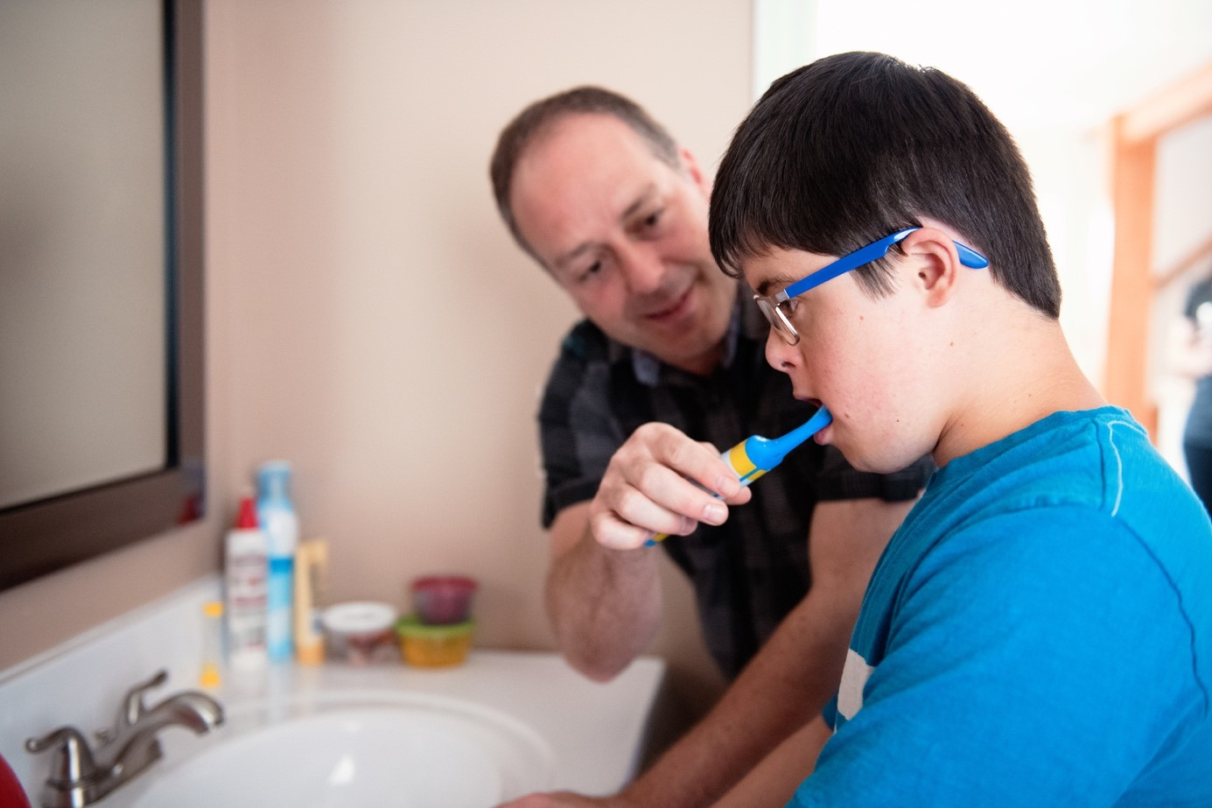
There are some clients who are unable to brush their teeth independently and you will need to brush their teeth for them.
Before any oral care procedure, you must:
Prepare the materials you will use
Wash your hands before and after providing oral care to the client. Make sure to put on disposable gloves during the procedures.
Provide Support Services

Slide 23
Before any oral care procedure, you must:
Cover the client’s body with a towel or waterproof sheet
Let them sit upright with pillows behind their back for support, for clients confined to bed
Position the client so that you can always:
Support their head
Ensure they will not choke or gag while their head is tilted
See properly inside their mouth and manipulate the toothbrush freely and safely
Provide Support Services

Slide 24
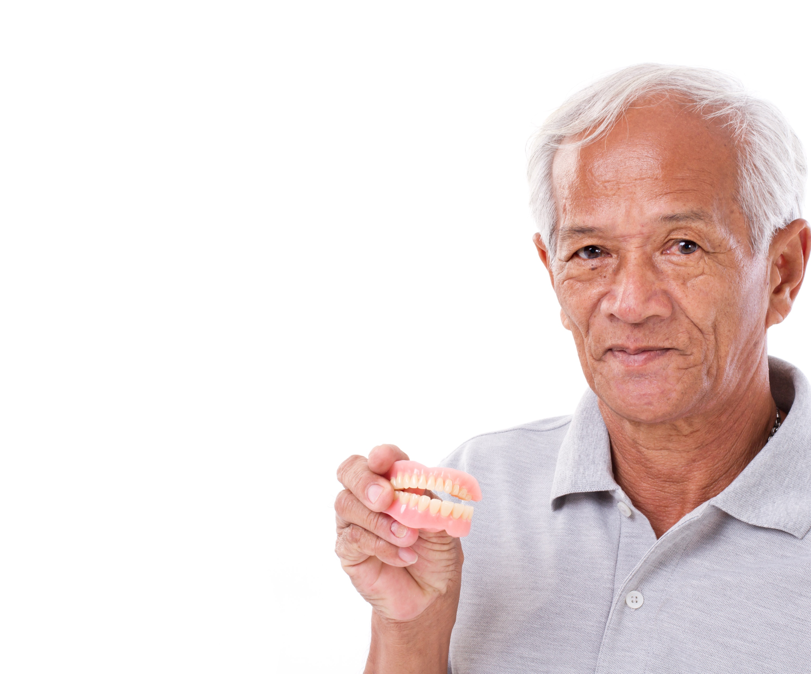
Before any oral care procedure, you must:
Encourage the client to tell them if they are feeling unwell or uncomfortable during the procedure
If the client has dentures, remove them before the oral procedures.
Provide Support Services

Slide 25
Consider the procedures below to provide oral care to clients depending on the kind of teeth the client has:
For clients with natural teeth and gums:
Check the inside of their mouth for any wounds or abnormalities. Hold the client’s chin to support their head as you inspect their teeth.
If the client lost some of their natural teeth, use a single-tuft toothbrush to brush around the tooth and gum line.
Provide Support Services

Slide 26
For clients with natural teeth and gums:
Brush the client’s teeth using the brushing process on Slides 17 – 20. Effective brushing technique also contributes to gum health.
Assist in using a gum stimulator for gum circulation.
Provide Support Services

Slide 27
Consider the procedures below to provide oral care to clients depending on the kind of teeth the client has:
For clients without natural teeth:
Wrap a piece of gauze around tweezers and soak it with water. Make sure to squeeze out the excess.
Swab the cheek first, then the other parts of the mouth in this sequence:
Gum of the upper arch
Gum of the lower arch
Palate
Tongue
Lips
Provide Support Services

Slide 28
Alternatives to Brushing
Lessen the intake of sugary food in the client’s diet.
Drink a lot of water after meals, medication, other drinks and snacks.
Wipe off plaque using a paper towel.
Gargle with alcohol-free oral rinses.
Chew sugar-free chewing gum.
Provide Support Services

Slide 29

Denture Care
Dentures are prosthetic devices made to replace missing teeth.
Many problems can arise for people with dentures such as:
Development of fungal infections
Denture sore mouth
Provide Support Services

Slide 30
Daily denture care involves the following processes:
Remove dentures after each meal to rinse both mouth and denture with water.
Drink water after meals to keep the mouth clean.
Brush dentures at least twice a day.
Remove dentures before sleeping to give the gums time to rest.
Soak cleaned dentures in a container of cold water.
Keep dentures moist at all times.
Clean denture storage containers daily.
Provide Support Services

Slide 31
Before any denture care process, make sure to:
Prepare materials necessary for denture hygiene
Check if the client’s denture and denture storage container are labelled
Wash your hands before the process
Ask the client to take a sip of water.
Provide Support Services

Slide 32
Consider the procedures of denture removal below depending on the type of denture:
For clients with full dentures:
Encourage the client to remove their full dentures on their own.
If the client requires help:
Start by removing the lower denture. Take out the denture by holding the lower front teeth with your thumb and index finger and lift it out.
Provide Support Services

Slide 33
Consider the procedures of denture removal below depending on the type of denture:
For clients with full dentures:
If the client requires help:
To remove the upper denture, break the adhesive seal by holding the front teeth with your thumb and index finger. Rock the denture up and down until the back is dislodged. Remove the denture at a sideways angle.
Provide Support Services

Slide 34
Consider the procedures of denture removal below depending on the type of denture:
For clients with full dentures:
If the client requires help:
If you are unable to break the adhesive seal, use the back of a toothbrush to carefully push down on the side of the denture. This should be pushed towards the back of the mouth until the denture is loosened.
Provide Support Services

Slide 35

Consider the procedures of denture removal below depending on the type of denture:
For clients with partial dentures:
Encourage the client to remove their partial dentures on their own.
Determine Personal Support Requirements

Slide 36
Consider the procedures of denture removal below depending on the type of denture:
For clients with partial dentures:
If the client requires help:
Place your finger under the clasps that cling unto the natural teeth and push down slowly.
Grasp the plastic part of the denture and lift it out of their mouth. Take care not to bend the wire clasps of the denture.
Provide Support Services

Slide 37
For denture cleaning, consider the procedure below:
Rinse the denture with warm water.
Using a soft-bristled toothbrush and mild soap, gently brush the denture to loosen and remove bacteria and plaque.
Clean all surfaces to remove dental plaque and any denture adhesive.
While cleaning, support the denture depending on its type.
Provide Support Services

Slide 38
For denture cleaning, consider the procedure below:
For dentures that have been relined with a soft cushion liner, use a soft toothbrush to clean them gently.
After brushing, rinse the dentures with warm water.
If the client is going to bed, soak the dentures in lukewarm water or denture-soaking solution.
Provide Support Services

Slide 39

Once cleaned, dentures are ready to be inserted into the client’s mouth.
For clients with loose-fitting dentures, consider using denture adhesives.
Always rinse the dentures with water before inserting them into the client’s mouth.
Provide Support Services

Slide 40
Once cleaned, dentures are ready to be inserted into the client’s mouth.
Encourage the client to insert their full or partial denture on their own.
If they need help, you must:
Ask the client to open their mouth
Hold the denture at a sideways angle as it enters the mouth
Rotate it into position (partial dentures should click into position)
Provide Support Services

Slide 41
Ill-fitting dentures give the client discomfort. Dentures may also become ill-fitting overtime as the mouth undergoes changes. Ways to recognize ill-fitting dentures include the following:
Client discomfort – your client may tell you directly or you may notice non-verbal cues such as grimacing or moving their mouth as if they are trying to adjust something.
Difficulty speaking and eating – your client may have difficulty pronouncing words. They may also take a long time to eat.
Provide Support Services

Slide 42
Ill-fitting dentures give the client discomfort. Dentures may also become ill-fitting overtime as the mouth undergoes changes. Ways to recognize ill-fitting dentures include the following:
Presence of mouth ulcers – irritation from ill-fitting dentures rubbing against the gums can lead to ulcers and sores.
Slipping of dentures – dentures should ideally remain in place even when the client is talking or eating.
Provide Support Services

Slide 43

2.1.4 Toileting
Some clients may need little to no help going to the toilet.
The amount of support a client may require for toileting can vary.
Make sure then to consult with clients and their individualised plan for information on how they should be supported.
Provide Support Services

Slide 44
Consider the following processes and procedures to provide support for toileting:
Discuss with the client how they will communicate their need to you.
Take note of signs of the need to go to toilet the client may exhibit.
Establish a regular schedule.
Encourage the client to pull their clothing down or up independently.
Provide Support Services

Slide 45
Consider the following processes and procedures to provide support for toileting:
Support the client to get on and off the toilet.
Allow the client time to empty their bladder and bowel.
Hand the client toilet paper to use when needed.
Be prepared for clients who menstruate.
Provide Support Services

Slide 46
Using Continence Aids
Client may have their own assistive aids for continence, such as a commode, catheter or bedpan.
Continence aids:
Are more convenient for a client to use at night
Can decrease the risk of falls and incontinence
Provide Support Services

Slide 47
2.1.5 Grooming
Grooming can involve the following:
Dressing and undressing
Hair care
Nail care
Shaving
Provide Support Services

Slide 48
Dressing and Undressing
With people receiving support, they may have difficulty with dressing and undressing so you must provide them support in performing these activities.
This support includes ensuring that clients are dressed appropriately for the weather to keep warm.
Provide Support Services

Slide 49
Consider the following processes to provide support to clients for this particular activity:
Find clothes that are comfortable and loose-fitting to clients.
Find clothes that have fasteners that are easy for clients to use.
Buy more than one set of the same clothes.
Put away some clothes in another room to reduce the number of choices.
Provide Support Services

Slide 50
Consider the procedures below when providing support to clients when dressing and undressing:
Undressing Clients:
Always ask the client if they want to undress.
Close the door and draw the curtains when it is time for the client to undress.
Encourage the client to remove their clothes independently.
If the client requires help, be gentle with your movements.
Provide Support Services

Slide 51
Consider the procedures below when providing support to clients when dressing and undressing:
Undressing Clients:
For clients with disabled limbs, minimise stressing the limb by undressing it last.
Make use of simple dressing assistive aids, such as dressing sticks or long-handled shoehorns.
Provide Support Services

Slide 52
Consider the procedures below when providing support to clients when dressing and undressing:
Dressing Clients:
Lay out clothes in the process the client should put them on, such as:
Underwear
Bottom clothing
Top clothing
Outerwear
Provide Support Services

Slide 53
Consider the procedures below when providing support to clients when dressing and undressing:
Dressing Clients:
Hand the client one clothing at a time.
Similar to undressing, encourage the client to put on as many clothes as they can on their own.
Provide Support Services

Slide 54

Hair Care
Similar to clothing, a person’s hairstyle can show their personality and preference.
Having well-groomed hair is important to everyone.
How it is groomed depends on what the person wants.
Provide Support Services

Slide 55
When supporting clients with their hair care, consider the following procedure:
Ask the client what their preference for their hairstyle for the day is.
Assist the client in styling their hair.
Aid the client in combing or brushing their hair from the scalp to the ends.
Encourage the client to look in the mirror after styling.
Provide Support Services

Slide 56

Shaving
For clients who wish to shave, it is vital that you support them to shave safely.
Consider the procedure below in supporting the client in shaving facial, leg or underarm hair.
Gather the necessary materials for the activity.
Provide Support Services

Slide 57
Consider the procedure below in supporting the client in shaving facial, leg, or underarm hair.
Ensure that the activity will be done safely.
Encourage the client to shave as much as possible on their own.
Assist the client to check their skin for moles, birthmarks or cuts.
Assist the client to prepare the materials for the activity.
Provide Support Services

Slide 58
Consider the procedure below in supporting the client in shaving facial, leg, or underarm hair.
For shaving with a blade razor, consider the process below:
Wash the area to be shaved with warm, soapy water.
Apply shaving cream or lather with soap.
Use the fingers of one hand to hold the skin-tight.
Provide Support Services

Slide 59
Consider the procedure below in supporting the client in shaving facial, leg, or underarm hair.
For shaving with a blade razor, consider the process below:
Regularly rinse the razor with water to remove hair and shaving cream.
Use short strokes when shaving the different parts for shaving.
Once the client is done shaving, rinse off the remaining shaving cream.
Provide Support Services

Slide 60
Consider the procedure below in supporting the client in shaving facial, leg, or underarm hair.
For shaving with an electric razor, consider the process below:
Instruct the client how to safely turn on the electric razor.
Assist the client to use a mirror while shaving their face or under their arms.
Use gentle, even pressure as the electric razor moves over the client’s skin.
Demonstrate how to clean hair from the blades as needed during the activity.
Provide Support Services

Slide 61
Consider the procedure below in supporting the client in shaving facial, leg, or underarm hair.
If the client wants to use aftershave or body lotion, assist them in applying the lotion.
If the face has been shaved, offer the client a mirror.
Clean and store all the materials used for the activity.
Encourage the client to wash their hands after shaving.
Provide Support Services

Slide 62

Nail Care
Another activity that improves the wellbeing of a person is taking care of nails.
Bacteria can often collect underneath the nails.
A good way to prevent this build-up is with frequent and thorough hand and foot washing.
Provide Support Services

Slide 63
Fingernails and toenails must be kept clean, neatly trimmed and smooth.
Consider the procedure below when providing support for nail care:
Prepare the necessary materials for the activity.
Have the client soak their hands or feet in warm water for at least five minutes.
Demonstrate to the client how to gently push the nail cuticle back with the cuticle stick.
Provide Support Services

Slide 64
Fingernails and toenails must be kept clean, neatly trimmed, and smooth.
Consider the procedure below when providing support for nail care:
Clean under the nails with the cuticle stick.
Wash the client’s hands or feet with clean water.
Use the nail clippers or nail scissors to trim the nails.
Use the nail file to shape and smooth the nails.
Provide Support Services

Slide 65
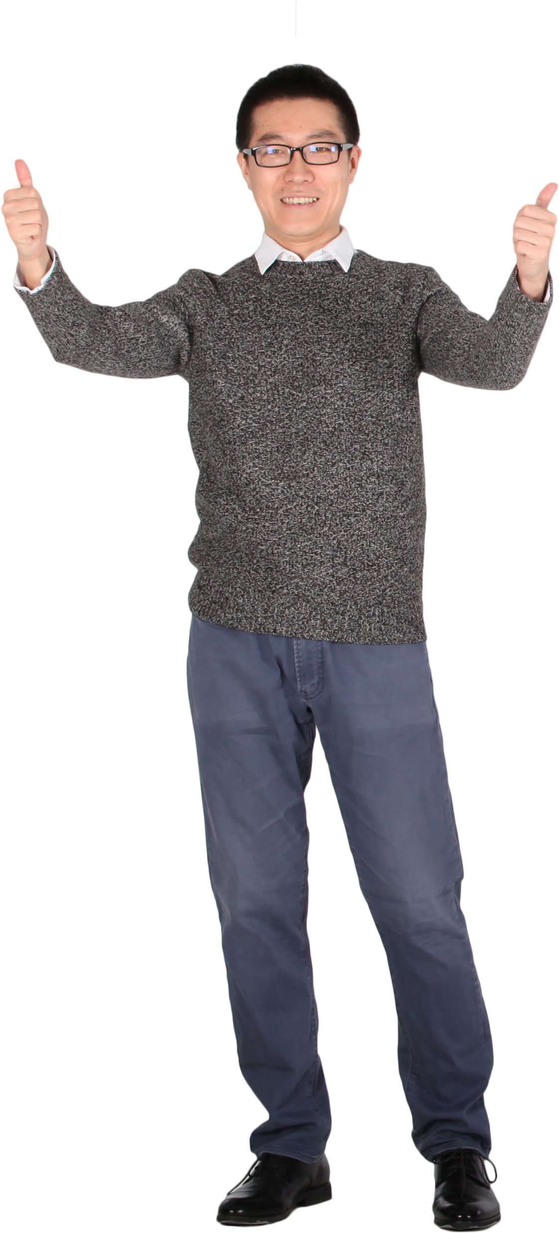
2.1.6 Eating and Drinking
To provide support to clients when eating and drinking, consider the procedure below:
Review the client’s individualised plan.
Identify any difficulties the client may have when eating or drinking.
Prepare any assistive device or equipment the client will need during mealtime.
Determine Personal Support Requirements

Slide 66
To provide support to clients when eating and drinking, consider the procedure below:
Ensure that the client has physical access to their food.
For clients who will eat their meals in their rooms, make sure that the room is clean before mealtime.
Allow the person the opportunity to go to the bathroom to wash their hands before each meal.
Encourage the client to eat their meal independently.
Provide Support Services

Slide 67
To provide support to clients when eating and drinking, consider the procedure below:
Engage with the client during the meal.
After the meal, help the person wipe their mouth and take care of their oral hygiene.
Recommend the client to remain in a sitting position for at least thirty minutes.
Provide Support Services

Slide 68

2.1.7 Mobility and Transferring
Mobility restrictions can affect a person’s ability to perform specific activities, such as going to the bathroom or eating a meal.
As a care worker, you must provide clients support when transferring or recovering from a fall.
Provide Support Services

Slide 69
Transferring the Client From Seated to Standing
Consider the following procedure:
Before the transfer, ensure that the client does not feel dizzy or lightheaded.
Place a gait belt around the client’s waist if needed.
Instruct the client to move forward toward the edge of where they are seated.
Place the client’s hands on the armrests of the chair or next to their sides on the bed.
Provide Support Services

Slide 70

Consider the following procedure:
Facing the client, bend your knees and hold each side of the client’s waist or gait belt.
Gently rock back and forth three times. On the third time, pull the client into a standing position.
Provide Support Services

Slide 71
Transferring the Client Between Bed and Chair
Consider the following procedure:
Prepare for the transfer.
Lower the client’s bed. Place the chair next to the bed at a 45-degree angle on the client’s strong side.
Have the client sit on the side of the bed with their feet on the floor.
Provide Support Services

Slide 72
Consider the following procedure:
Assist the client into a standing position.
Once standing, have the client take a few steps back until they can feel the chair on the back of their legs. Have the client grasp the arm of the chair and lean forward.
Allow the patient to sit on the chair slowly, using armrests for support. Make sure that your knees are bent, and your back is straight to avoid injury.
Provide Support Services

Slide 73

Transferring the Client Into Car
Consider the following procedure:
Position the client alongside the car.
Inform the client about the transfer and what you will do.
Provide Support Services

Slide 74
Consider the following procedure:
Ensure that the brakes of the wheelchair have been applied. Move the client’s legs from the footrests of the wheelchair. Then, detach the footrests from the wheelchair.
Let the client know that you will begin the transfer.
Place your legs apart with the client’s legs in-between yours.
Place your arms underneath the armpits of the client and lay your hands on their back.
Provide Support Services

Slide 75
Consider the following procedure:
Lift the client into a standing position.
Take small steps backward, keeping your arms and hands in the same position until you are positioned behind the car door.
Let the client choose whether they want to hold onto the car for extra support.
Turn the client until their back is facing the passenger seat.
Provide Support Services

Slide 76
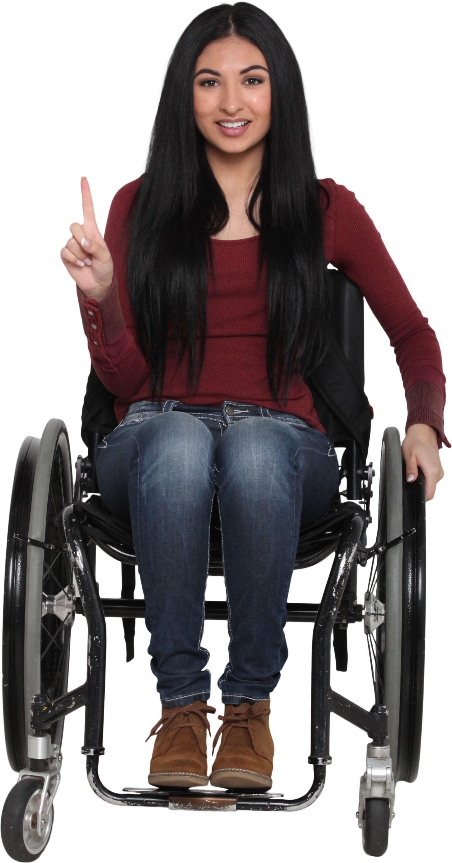
Consider the following procedure:
Slowly lower the client onto the seat, bending your knees as you go.
Once the client is seated, place your right arm underneath their legs, keeping your left arm in the same position as in Step 10.
Determine Personal Support Requirements

Slide 77

Consider the following procedure:
Once the client is comfortable, encourage the client to buckle their seatbelt.
Ensure that the client’s hands, arms and legs are inside the car. Once they are secured, you can close the car door.
Provide Support Services

Slide 78
Transferring the Client Out of Car
Consider the following procedure:
Position the client’s wheelchair and position it alongside the car.
Open the car door and ask the client to unbuckle their seatbelt.
Be sure to inform the client about the transfer and what you will do.
Provide Support Services

Slide 79
Consider the following procedure:
Support the client’s back using your left arm, laying your left hand flat on the far side of their back. Position your right arm underneath your client’s legs.
Swing the client’s legs out of the car.
Move your arms underneath the client’s armpits, with your hands flat on their back. Then, lift the person out of the car seat.
Provide Support Services

Slide 80
Consider the following procedure:
Once you are both standing, have the client take a few steps back until they can feel the chair on the back of their legs. Have the client grasp the arm of the chair and lean forward.
Allow the patient to sit on the wheelchair slowly, using armrests for support.
Provide Support Services

Slide 81
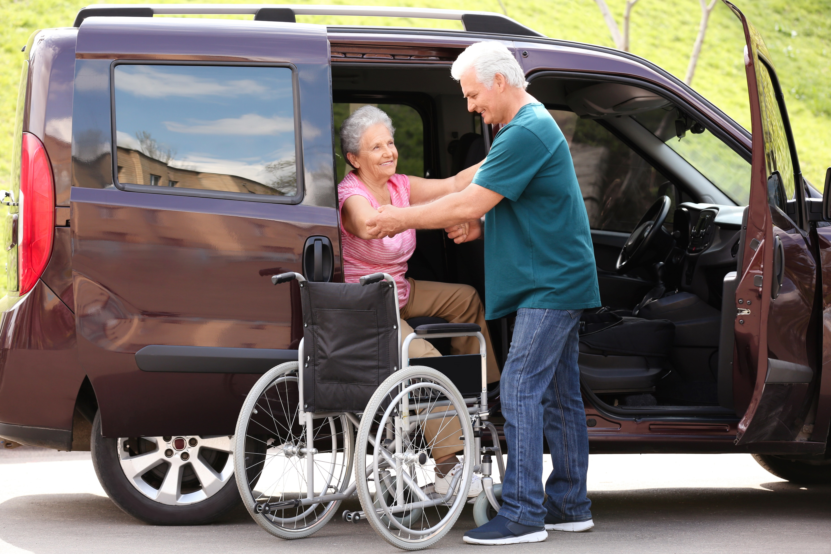
Consider the following procedure:
Attach the footrests to the wheelchair. Once they are attached, position the client’s feet on the footrest.
Once the client is seated comfortably, remove the brakes before moving the client with the wheelchair.
Provide Support Services

Slide 82
Using Transferring Aids
In some cases, client may require the use of transferring aids used to lift a person from one place to another , such as:
If a transferring aid is needed, make sure you know how to support the client with the aid.
Slide sheets
Hoists
Slings
Lifters
Provide Support Services

Slide 83
Falls Recovery
Falls are Australia’s most significant contributor to hospitalised injury cases.
The guidelines for providing support in falls recovery can be found in your organisation’s policies and procedures.
Provide Support Services

Slide 84

The guidelines for fall recovery will contain varying processes depending on the organisation. Usually, the processes include the following actions:
Reassure the client when they fall.
Check the client for any injuries.
Provide Support Services

Slide 85
Usually, the processes include the following actions:
Provide treatment as needed. If needed, call for help from other staff or supervisors.
Notify the client’s support team and your supervisors.
Ensure falls risk assessment and prevention strategies are updated and implemented.
Provide Support Services

Slide 86
Manual Handling and Falls Recovery
Manual handling skills is crucial in helping clients recover from falls. You can use manual handling in assisting the client to do the following:
Getting into a comfortable positions
Moving from one place to another
Regaining mobility
Sitting down
Standing up
Provide Support Services

Slide 87
Below are some manual handling techniques used in assisting with falls recovery::
Providing steady support when the client tries to stand up or move
Working with another person to transfer the client
Using mechanical aids (e.g. hoists, lifts)
Provide Support Services

Slide 88
When using these techniques, you must follow guidelines recommended by your organisation. These guidelines may include the following:
Determine the condition of the client (e.g. type of injury, severity of injury, weight-bearing capacity).
Use techniques that maximise the comfort of the client.
Seek consent from client before applying manual handling techniques.
Provide Support Services

Slide 89
When using these techniques, you must follow guidelines recommended by your organisation. These guidelines may include the following:
Ensure you have proper training when using mechanical aids.
Communicate with the client and your partner when implementing manual handling techniques.
Ask the client if they are comfortable.
Provide Support Services

Slide 90
2.1.8 Skill Maintenance and Development
Skill maintenance and development identify gaps in a person’s skill set and improve these skills accordingly.
Building skills helps people live independent lives.
Maintaining and developing these skills make sure that a person can achieve a good quality of life.
Provide Support Services

Slide 91
Examples of practices that support skill maintenance include:
Reinforcing techniques
Skills component mastery
Prompting and fading
Community education
Provide Support Services

Slide 92
Examples of practices that support skill maintenance include:
Reinforcing Techniques
Application of the Behaviourist Theory of Learning
Used to increase the likelihood of doing the desired behaviour
Provide Support Services

Slide 93
Examples of practices that support skill maintenance include:
Skills Component Mastery
Aims to ‘master’ or achieve a level of performance for a particular skill component
Focuses on the time required for different people to perform the same skill and achieve the same level of mastery
Provide Support Services

Slide 94
Examples of practices that support skill maintenance include:
Prompting and Fading
Prompting is the way of ‘prompting’ or inducing the client to perform a particular behaviour by presenting a prompt.
Fading is gradually reducing the prompt.
Community Education
Aims to enable people to become active partners in the community
Provide Support Services

Slide 95
Examples of practices that support skill development include:
Assessing the person’s physical capabilities, their strengths, what they want to learn/achieve and what skills will support their independence
Focusing on developing one skill at a time while removing distractions or hazards in the environment
Provide Support Services

Slide 96
Examples of practices that support skill development include:
Supporting clients to set S-M-A-R-T goals in relation to skills they want to develop
Aligning goal setting with the client’s individualised support plan.
Provide Support Services

Slide 97

2.2 Support the Person’s Use of Assistive Technologies

Slide 98
Assistive technology refers to the devices and equipment designed to support PWDs.
Using assistive technology can do the following:
Positively impact the health and wellbeing of the person
Maintain and promote the independence of the person
Support the inclusion of the person
Support the participation of the person
Ease the process for making choices and decisions for the person
Provide Support Services

Slide 99
2.2.1 Scope and Breadth of Assistive Technology
Scope refers to the activities where a person can use assistive technology.
Breadth refers to the range of devices and equipment used explicitly for an activity.
Assistive technology is beneficial and useful to your clients mainly on the following:
For example, assistive technology is used to support people in their homes or care residences. This may include those used by carers, people with disabilities and those adapted to the facilities.
Communication
Daily living activities
Provide Support Services

Slide 100
One of the common individual needs of a person is the need to communicate and interact with others.
The following tables list down the breadth of assistive technology used for communication.
Impairment | Breadth of assistive technology
Hearing | FM systems Closed-captioning software
Provide Support Services

Slide 101
The following tables list down the breadth of assistive technology used for communication.
Impairment | Breadth of assistive technology
Speech | Communicators Eye gaze Text-to-speech software
Vision | Alternative print materials Alternative keyboards
Provide Support Services

Slide 102
The following tables list down the breadth of assistive technology used for communication.
Impairment | Breadth of assistive technology
Vision | Pocket magnifiers Audiobooks Reading gadgets Refreshable Braille displays Visual support software
Provide Support Services

Slide 103
The following tables list down the breadth of assistive technology used for communication.
Impairment | Breadth of assistive technology
Cognition and Memory Loss | Sensory regulators Noise-cancelling headphones Cueing/memory aids Word prediction software
Provide Support Services

Slide 104
Daily Living Activities
The following tables list down the breadth of assistive technology used for the kinds of activities for daily living.
ADL/IADL | Breadth of assistive technology
Continence | Bedpan Bedside commode Bed and chair pads Toilet seat raisers Catheter
Provide Support Services

Slide 105
The following tables list down the breadth of assistive technology used for the kinds of activities for daily living.
ADL/IADL | Breadth of assistive technology
Hygiene | Grab bars Shower chair or bench Anti-slip mats Dressing aids
Provide Support Services

Slide 106
The following tables list down the breadth of assistive technology used for the kinds of activities for daily living.
ADL/IADL | Breadth of assistive technology
Mobility and Transferring | Wheelchair Walking sticks, walkers, crutches and canes Prosthetic devices Slide sheet Gait belt
Provide Support Services

Slide 107
The following tables list down the breadth of assistive technology used for the kinds of activities for daily living.
ADL/IADL | Breadth of assistive technology
Mobility and Transferring | Transfer board Sling Stretcher Hoist
Provide Support Services

Slide 108
The following tables list down the breadth of assistive technology used for the kinds of activities for daily living.
ADL/IADL | Breadth of assistive technology
Eating and Drinking | Adaptive dinnerware Assistive utensils Utensil holders Feeding devices Assistive cups and mugs
Provide Support Services

Slide 109
The following tables list down the breadth of assistive technology used for the kinds of activities for daily living.
ADL/IADL | Breadth of assistive technology
Pressure Area Management | Protectors Cushions Offloading footwear Sleep positioners
Provide Support Services

Slide 110
The following tables list down the breadth of assistive technology used for the kinds of activities for daily living.
ADL/IADL | Breadth of assistive technology
Pressure Area Management | Electronic bed frames Specialised pressure relief wheelchair cushions Pressure relieving mattress
Provide Support Services

Slide 111
The following tables list down the breadth of assistive technology used for the kinds of activities for daily living.
ADL/IADL | Breadth of assistive technology
Carer Support | Fall detectors Passive infra-red detectors Panic buttons Personal alarms Smart plugs
Provide Support Services

Slide 112
The following tables list down the breadth of assistive technology used for the kinds of activities for daily living.
ADL/IADL | Breadth of assistive technology
Recreation and Leisure | Adapted equipment Switch-adapted equipment
Education and Employment | Ergonomic furniture Pen/pencil grips Graphic organisers
Provide Support Services

Slide 113
The following tables list down the breadth of assistive technology used for the kinds of activities for daily living.
ADL/IADL | Breadth of assistive technology
Education and Employment | Audio recordings Speech-to-text software Physical modifications to the environment
Provide Support Services

Slide 114
2.2.2 Providing Support When Using Assistive Technology
In supporting your clients’ use to meet their individual needs, you need to take into consideration the following processes and procedures:
Confirm, assemble and prepare the equipment, aids and appliances to be used for the client’s support activities.
Consider the client’s environment.
Ensure that the person understands how to use the assistive technology.
Make sure that assistive devices and equipment are well-maintained.
Provide Support Services

Slide 115

2.3 Assist the Person to Take Pre-Packaged Medication According to Requirements

Slide 116
Medications are substances used to prevent, treat or alleviate illnesses or symptoms. Pre-packaged medications refer to medications that have been taken out of their original container.
As a care worker, you must ensure that your clients take their pre-packaged medications correctly.
If clients are not assisted correctly, they put themselves at risk.
Provide Support Services

Slide 117
2.3.1 Most Commonly Used Medications
Before assisting your clients, you must be familiar with the most commonly used medications.
The medications can either be:
Prescription - medication that legally requires a prescriber to approve its use
Over the counter - does not require a prescriber.
Provide Support Services

Slide 118
Twenty commonly used medications are:
Atorvastatin
Lisinopril
Metoprolol
Rosuvastatin
Bupropion
Metformin
Amlodipine
Sertraline
Omeprazole
Gabapentin
Provide Support Services

Slide 119
Twenty commonly used medications are:
Montelukast
Amoxycillin
Losartan
Hydrochloro-thiazide
Simvastatin
Pantoprazole
Fluticasone
Escitalopram
Furosemide
Fluoxetine
Provide Support Services

Slide 120
Keep in mind that this is not an exhaustive list of contraindications. Regardless of the medication, you must be informed of the following your clients may have:
Allergies
History of illnesses within their family
Pregnancy, breastfeeding or the intention to either
Medication history
Other medications currently being taken
Other illnesses and medical conditions
Provide Support Services

Slide 121
2.3.2 Written Directions From the Client’s Health Professional
Written direction refers to instructions that provide information on the following:
What the pre-packaged medication is
How the pre-packaged medication should be taken
How many times the client must take the pre-packaged medication
What the correct dosage of the pre-packaged medication is
Provide Support Services

Slide 122
Rights of Medication
Rights of medication assist healthcare professionals and care workers in preventing medication errors.
Right | Breadth of assistive technology
Right Person | Before assisting clients, confirm their identity by asking or looking for their identifiers. The client’s name
Provide Support Services

Slide 123
Rights of medication assist healthcare professionals and care workers in preventing medication errors.
Right | Breadth of assistive technology
Right Person | Before assisting clients, confirm their identity by asking or looking for their identifiers. Date of birth Medical Record Number (MRN), which is an identifier given by the health organisation of the client
Provide Support Services

Slide 124
Rights of medication assist healthcare professionals and care workers in preventing medication errors.
Right | Breadth of assistive technology
Right Medication | You must make sure that: The medication is what is prescribed by the client’s health professional The package of the medication is not tampered with The medication is within an expiry date
Provide Support Services

Slide 125
Rights of medication assist healthcare professionals and care workers in preventing medication errors.
Right | Breadth of assistive technology
Right Dose | You must make sure that the dosage is correct before the client takes it. Dosage will vary according to the client’s age, size and health condition.
Provide Support Services

Slide 126
Rights of medication assist healthcare professionals and care workers in preventing medication errors.
Right | Breadth of assistive technology
Right Time | Check for information on when and how often the medication must be taken by the client. Taking medication at the prescribed time is essential in ensuring the effectiveness on the client’s body.
Provide Support Services

Slide 127
Rights of medication assist healthcare professionals and care workers in preventing medication errors.
Right | Breadth of assistive technology
Right Route | Medication needs to be taken through a specific route.
Right Reason | Consult with the client and their health professional for the appropriate symptoms to watch out for to ensure that the medication will be given for the correct reasons.
Provide Support Services

Slide 128
Rights of medication assist healthcare professionals and care workers in preventing medication errors.
Right | Breadth of assistive technology
Right Documentation | Each and every time the client takes their pre-packaged medication should be recorded.
Provide Support Services

Slide 129
2.3.3 Legislative Requirements and Organisational Policies and Procedures
You will also need to work within the legislative requirements for medication.
Enforcing these laws ensure that the care you provide to your clients upholds their rights, including the following:
The right to refuse medication
The right to be educated
Provide Support Services

Slide 130
The legal and ethical requirements for medication are provided through the following:
Disability Services Act 1986
Work Health and Safety Act 2011
Aged Care Act 1997
Poisons Standard October 2021
Drugs and Poisons Act
Provide Support Services

Slide 131
The legal and ethical requirements for medication are provided through the following:
Disability Services Act 1986
The Disability Services Act 1986 lists flexible provisions that are responsive to the needs and goals of people with disabilities.
Aged Care Act 1997
The Aged Care Act 1997 lists flexible provisions for aged care.
Provide Support Services

Slide 132
The legal and ethical requirements for medication are provided through the following:
Work Health and Safety Act 2011
Work health and safety ensure the safety of you, your clients and those involved in their care.
Provide Support Services

Slide 133
Workplace health and safety is twofold:
Workplace Health
Workplace Safety
Refers to the prevention of illness and other medical conditions
Refers to the prevention of harm resulting in injuries or death
Provide Support Services

Slide 134
The legal and ethical requirements for medication are provided through the following:
Poisons Standard October 2021
This law dictates which medications need to be prescribed.
The Standard for the Uniform Scheduling of Drugs and Poisons (SUSDP) document contains information on drug schedules.
Provide Support Services

Slide 135
The legal and ethical requirements for medication are provided through the following:
Drugs and Poisons Act
These laws are written to ensure the safety of the people.
Generally, they provide restrictions on the prescription, distribution and use of drugs and poisons.
Provide Support Services

Slide 136
2.3.4 Providing Assistance
Consider the procedure below when physically assisting clients in taking medication pre-packaged by a pharmacist:
Apply the rights of medication.
Carefully review the client’s pre-packaged medication.
Inform the client of the medication’s purpose and side effects.
Double-check all relevant documents about the client’s pre-packaged medication.
Ask the client how they prefer to be assisted.
Oversee how the client takes their pre-packaged medication.
Provide Support Services

Slide 137
Adverse Reactions to Medication
Adverse reactions:
Are unexpected and detrimental reactions to a medication
Can be life-threatening or a cause for hospitalisation or extended hospitalisation
May be sudden or delayed
Provide Support Services

Slide 138
General signs of adverse reactions include the following:
Redness and itching
Hair loss
Drowsiness
Myelosuppression
Stomach cramps
Diarrhea or constipation
Vomiting and nausea
Dizziness
Heartburn
Provide Support Services

Slide 139

Consider the procedure below when responding to clients’ adverse reactions to medication within the scope of your own job role:
Contact the client’s health professionals immediately.
If you cannot contact the client’s health professionals:
Seek help from the Medicines helpline at 1300 MEDICINE (1300 633 424).
Provide Support Services

Slide 140
Consider the procedure below when responding to clients’ adverse reactions to medication within the scope of your own job role:
If you cannot contact the client’s health professionals:
Seek help from the 24-hr helpline from Health Direct Australia at 1800 022 222.
If you suspect an overdose or poisoning, call the Poisons Information Centre on 13 11 26.
Provide Support Services

Slide 141
Consider the procedure below when responding to clients’ adverse reactions to medication within the scope of your own job role:
For adverse reactions that occur in a home setting, call an ambulance at Triple Zero (000). Secondary emergency numbers include 112 and 106.
Document the adverse reaction in an incident report.
Incident reports are reports that detail negative events that happened.
Report the adverse reaction to the relevant personnel.
Provide Support Services

Slide 142
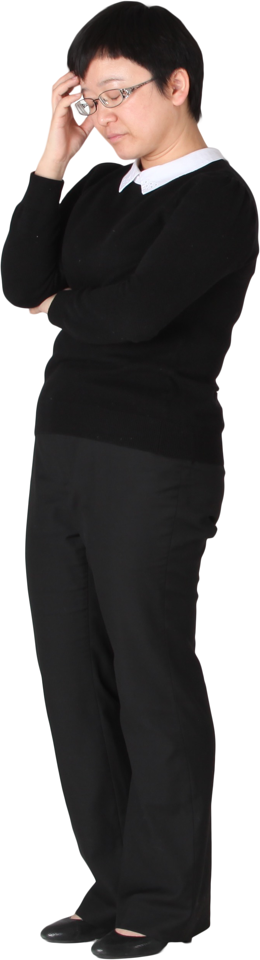
Escalation if Clients are Unable to Take Medication
When the client refuses to take pre-packaged medication, consider the procedure below:
Ask the client why they do not want to take the medication.
Calmly explain the consequences of not taking their pre-packaged medication.
Determine Personal Support Requirements

Slide 143
When the client refuses to take pre-packaged medication, consider the procedure below:
If the medication is still refused, document the situation.
Escalate the situation by reporting to the client’s healthcare professional and your supervisors.
Provide Support Services

Slide 144
In the case that the refusal of the medication has serious consequences on the health and wellbeing of the person, the following steps may be undertaken:
Consideration should be given to assessing the person’s capacity to refuse medication.
Efforts should be made to ascertain the reasons for the refusal and whether these can be addressed by providing alternative treatment or by other means.
Sensitive cultural and religious issues should be accommodated, where possible.
Provide Support Services

Slide 145

2.4 Respect and Include the Person’s Relevant Others as Part of the Support Team

Slide 146
Each individual has their responsibilities in ensuring that the person gets the care they need.
As a care worker, you must respect and include the carer, family and others identified by your clients as part of their support team.
Respect refers to believing that the person is valued.
This involves providing support that recognises the individuality and preferences of the person.
Provide Support Services

Slide 147
The National Disability Insurance Scheme (NDIS) supports people with disabilities and their support team.
The NDIS Rules outlines the objectives of the scheme, which include:
Supporting the independence and participation of people with disabilities in society
Providing reasonable and necessary supports for NDIS participants
Enabling people with disabilities to exercise choice and control in pursuit of their goals
Promoting the provision of high quality supports to people with disabilities.
Provide Support Services

Slide 148
According to the principles set in the NDIS Act, the preparation of a person's plan and management of the funding for support should:
Be individualised
Be directed by the participant
Where relevant, consider and respect the role of family, carers and other persons who are significant in the life of the participant
Provide Support Services

Slide 149
According to the principles set in the NDIS Act, the preparation of a person's plan and management of the funding for support should:
Where possible, strengthen and build the capacity of families and carers to support participants
Consider the availability to the participant other support services generally available to any person in the community
Support communities to respond to the individual goals and needs of participants
Provide Support Services

Slide 150

According to the principles set in the NDIS Act, the preparation of a person's plan and management of the funding for support should:
Be underpinned by the right of the participant to exercise control over their own life
Promote the inclusion and participation of the participant in their community to achieve their goals
Provide Support Services

Slide 151
According to the principles set in the NDIS Act, the preparation of a person's plan and management of the funding for support should:
Maximise the choice and independence of the participant
Facilitate tailored and flexible responses to the individual goals and needs of the participant
Provide the context for the provision of disability services to the participant
Where appropriate, coordinate the delivery of disability services with more than one disability service provider.
Provide Support Services

Slide 152
Principles Underlying Respectful Behaviour
The principles underlying respectful behaviour are as follows:
Integrity
Integrity refers to being honest and having strong moral principles.
Fairness
Fairness refers to treating people the same no matter their race, religion, age and more.
Provide Support Services

Slide 153
The principles underlying respectful behaviour are as follows:
Collaboration
Collaboration refers to the willingness to work with others.
Professionalism
Professionalism refers to treating your co-workers, supervisors and other personnel with respect.
Provide Support Services

Slide 154
As a support worker, you must demonstrate respectful behaviour towards a client’s:
Goals
Needs
Preferences
Physical, social, emotional, psychological health and well-being
Cultural beliefs and practices
Provide Support Services

Slide 155
As a support worker, you must demonstrate respectful behaviour towards a client’s:
Diversity
Privacy and confidentiality
Relationships (family members, carers, friends, etc.)
Rights and dignity.
Provide Support Services

Slide 156
2.4.1 Respect the Carer, Family and Others Identified by Clients as Part of the Support Team
Below are some ways you can show your respect to the carer, family, and others identified by your clients as part of the support team:
Consider the relationship of the client with their carer, family and others identified by the client.
Acknowledge that the carer, family and others identified by the client play a vital role in supporting the client.
Provide Support Services

Slide 157
Below are some ways you can show your respect to the carer, family, and others identified by your clients as part of the support team:
Acknowledge the different views of the carer, family and others identified by the client.
Recognise the challenges faced by the carer, family and others identified by the client.
Provide Support Services

Slide 158
2.4.2 Include the Carer, Family and Others Identified by Clients as Part of the Support Team
Each support team member has roles and responsibilities in the individualised plan thus, you must ensure that there is communication between you and the following:
Client receiving support
Family of the client
Carers of the client
Health professionals
Other support workers
Your supervisors
Provide Support Services

Slide 159
Briefings
Are short, structured meetings where those involved in the client's individualised plan talk about the client, the support service, the support activity or the situation
Provide a promising avenue for those involved to express themselves
Usually done face-to-face or through video conferencing, which requires the use of the internet.
Provide Support Services

Slide 160
Before the briefing, you may create the following checklist as a guide for the meeting:
Who will assist the client in the support activity?
Does everyone understand their assigned roles?
What are staff availability issues present?
What are the resources needed for the support activity? Are there any potential issues regarding the resources that can impact the activity?
Provide Support Services

Slide 161
Debriefings
Debriefings are brief and informal exchange and feedback sessions that occur after a support activity or situation.
Debriefings identify:
What happened during the activity or situation
What went well
What can be done better next time
Provide Support Services

Slide 162
Emails
A great way to send important files and documentation
Sent to those involved in the client's individualised plan
An effective tool for storing information that everyone can refer to at any time, such as:
Correspondence regarding details about the person's support services and activities
Meeting minutes of briefing or debriefing sessions
Provide Support Services

Slide 163
Cloud Storage
Is an online-based computer model for quick storage and access of files and documents
Allows you to store large-sized files or documentation, such as:
Images
Videos
And other graphics
Provide Support Services

Slide 164

2.5 Support the Person According to Considerations, Policies and Procedures

Slide 165
When providing support to clients, always remember that they must be assisted to take control of their life so you must take into consideration the following:
Duty of care refers to your legal obligation to always act in your clients’ best interest.
Dignity of risk refers to allowing your clients to take part in activities that may come with risks.
Duty of care
Dignity of risk
Provide Support Services

Slide 166
To provide support according to duty of care and dignity of risk, you must encourage your clients to make their own choices and decisions.
Choices and decisions are similar but slightly different:
Making a decision does not require the existence of alternatives. On the other hand, making a choice means that the client has various other options available to them.
Provide Support Services

Slide 167
Choices and decisions are similar but slightly different:
A decision is dependent on facts and relevant information. In contrast, a choice is only reliant on the client’s preferences, values or beliefs.
When the client makes a decision, they are going through analysis and evaluation to find the best course of action. When they make a choice, the client simply uses a mindset approach to pick among a variety of options.
Provide Support Services

Slide 168
Encouraging clients to make their own choices involves doing the following:
Give the client all essential options and information.
Use appropriate communication techniques to guide the client in making a choice.
Give the client time to think about their choice.
Assist the client in searching for additional information regarding the choices.
Provide Support Services

Slide 169
Encouraging clients to make their own choices involves doing the following:
Remind the client of the goals they set for themselves.
Assure the client that their choices and decisions are important and that it is alright to make mistakes now and then.
Remind the client that they can assign supporters to help them in making choices and decisions.
Provide Support Services

Slide 170
There is a danger to letting the clients make choices for themselves. Sometimes, a person who has many options to choose from will:
Take a long time making a choice, which, in turn, causes them to be stuck or unable to move forward
Feel unsatisfied or wanting after making a choice due to the possibility that one of the other choices could be better
Make the wrong choice more often, as having more options also means having more chances to make a mistake
Provide Support Services

Slide 171
You must support clients to make choices not to fall victim to these dangers as part of your dignity of risk to your clients. Doing this involves the following:
Reduce the need for the client to go through many options by using close-ended questions instead of open-ended questions.
Use appropriate modelling techniques to guide the client towards making responsible choices.
Help the client develop a personal method for making choices.
Provide Support Services

Slide 172

You must support clients to make choices not to fall victim to these dangers as part of your dignity of risk to your clients. Doing this involves the following:
Come up with a way for the client to communicate their choice.
Provide opportunities to make choices every day.
Determine Personal Support Requirements

Slide 173

2.5.1 Maintaining the Privacy of Clients
You must remember to support clients by maintaining their privacy which can be done by asking for their informed consent.
Informed consent refers to a person granting permission for others to any information that can be used to identify them.
Provide Support Services

Slide 174
Permission is informed if the person is given all essential details on the decision being made, including:
Possible outcomes of the decision
Risks involved with the decision
Effects that the decision may have on their financial assets
Provide Support Services

Slide 175
Informed consent is necessary in all cases, except when:
A court order requires you to provide information without the consent of the person
Giving information is needed to assist law enforcement agencies and other government agencies
There is reason to believe that the person is in danger or risk of harm, and the information is needed to file a report
Provide Support Services

Slide 176
Ensuring that clients can provide informed consent allows you to:
Prevent others from forcing the client into making a decision they disagree with
Remind the client that they must provide specific information when consenting, such as times for when the consent applies
Remind the client that they also can withdraw consent when necessary.
Provide Support Services

Slide 177
Ensuring that clients can provide informed consent allows you to:
Respect the client’s interests
Follow the procedures on privacy, confidentiality and disclosure
Discuss all essential details with the client and answer all questions
Identify if an option will present a substantial risk for harm to the client
Provide Support Services

Slide 178

2.5.2 Restrictive Practices
Restrictive practices involve the use of interventions and practices that have the effect of restricting the rights or freedom of movement of a person.
Ideally, this is done as a last option and only to ensure the safety of everyone involved.
Provide Support Services

Slide 179
There are five types of restrictive practices:
Chemical restraint
The practice or intervention involves the use of a medication or chemical substance.
The primary purpose is to influence a person's behaviour.
Environmental restraint
The practice or intervention involves restricting a person's access to all parts of their environment.
Provide Support Services

Slide 180
There are five types of restrictive practices:
Mechanical restraint
The practice or intervention involves the use of a device that restricts the movement of a person.
Physical restraint
The practice or intervention involves using physical force to restrict a person.
Seclusion
The practice or intervention involves the solitary confinement of a person.
Provide Support Services

Slide 181
Requirements for the Use of Restrictive Practices
The following requirements must be met for the use of any authorised restrictive practice:
Providers are required to document the alternatives to restrictive practices that have been considered and used, and why they have not been successful
Restrictive practices must only be used as a last resort to prevent harm to the client or other people.
An approved health practitioner has assessed the client as posing a risk of harm to themself or another person.
Provide Support Services

Slide 182

The following requirements must be met for the use of any authorised restrictive practice:
In the case of a chemical restraint, the assessments must be conducted by a medical or nurse practitioner.
Best practice alternative behaviour support strategies have been used.
Restrictive practices must only be used in proportion to the risk of harm.
Provide Support Services

Slide 183
The following requirements must be met for the use of any authorised restrictive practice:
The following must be continuously monitored, reviewed and documented:
Where any restrictive practices are used, the consumer must be regularly monitored for signs of distress or harm, side effects and adverse events among others
The need for restrictive practices
The use of restrictive practices
The effectiveness of restrictive practices
Provide Support Services

Slide 184
The following requirements must be met for the use of any authorised restrictive practice:
The use of the restrictive practice must be regularly reviewed by the provider with a view to removing it as soon as possible or practicable
Providers are required to develop and implement a behaviour support plan
Provide Support Services

Slide 185
The following requirements must be met for the use of any authorised restrictive practice:
Care providers must consider whether an individually appropriate alternative strategy can be used.
Informed consent for the use of a restrictive practice must be obtained from the person.
Provide Support Services

Slide 186
The following requirements must be met for the use of any authorised restrictive practice:
The use of restrictive practices must comply with the following legislative and regulatory requirements:
The Charter of Aged Care Rights
Aged Care Quality Standards
National Standards for Disability Services
The requirements of the law of the State or Territory in which the restrictive practice is used
Any relevant provisions of the person's care or behaviour support plan
Provide Support Services

Slide 187
All providers using authorised restrictive practices must meet conditions of registration, which include:
A restrictive practice can only be used when it is part of a behaviour support plan developed by an NDIS behaviour support practitioner
If a restrictive practice is used, it must:
Be the least restrictive response possible in the circumstances
Reduce the risk of harm to the person or others
Provide Support Services

Slide 188
All providers using authorised restrictive practices must meet conditions of registration, which include:
If a restrictive practice is used, it must:
Be used for the shortest possible time to ensure the safety of the person or others
Where required, the implementing provider must obtain authorisation for the use from the state or territory
The implementing provider must comply with monthly reporting requirements
Provide Support Services

Slide 189

The use of restrictive practices is unauthorised if it is:
Without authorisation by the relevant state or territory (however described), or
Not in accordance with a behaviour support plan
Provide Support Services

Slide 190

Organisational Policies and Procedures
Each provider will have policies and procedures on the use of restrictive practices that must be in line with the following:
Requirements for the authorised use of restrictive practices
State and territory legislation
Provide Support Services

Slide 191
Ethical Considerations
The UN Convention on the Rights of Persons with Disabilities protects people receiving support from:
Cruel and inhumane treatment
Degradation or humiliation
Violence or abuse
Provide Support Services

Slide 192
Documentation Requirements
In the NDIS Rules legislation, it states that the documentation must include:
A description of the use of the practice
A description of the person's behaviour prior to the practice
The time, date and place of use
Provide Support Services

Slide 193
In the NDIS Rules legislation, it states that the documentation must include:
The names and contact details of people involved, including witnesses
Other less restrictive options used
Strategies used to prevent the use of restrictive practice
Actions taken in response to the use of the practice
Provide Support Services

Slide 194
Using Positive Strategies To Eliminate The Need To Use Restrictive Practices
Restrictive practices can cause:
Serious physical injury or death
Psychological harm
Damage between the relationship of a person and their carers
Increased power imbalances
Feelings of helplessness
A loss of independence
Provide Support Services

Slide 195
Using restrictive practices conflicts with the following human rights:
The right to be free from violence and abuse, and torture or cruel, inhuman or degrading treatment
The right to physical and mental integrity, liberty and autonomy
Provide Support Services

Slide 196
The following strategies are used to reduce and eliminate the use of restrictive practices:
Life-course strategy - This strategy recognises that all stages of a person's life are connected.
Life-course strategy
National strategies
State and territory strategies
Provide Support Services

Slide 197
The following strategies are used to reduce and eliminate the use of restrictive practices:
National strategies - There have been three national agreements to reduce or eliminate the use of restrictive practices in Australia:
In 2005, Health Ministers agreed to reduce, or if possible, eliminate the use of some restrictive practices. This use is in mental health settings.
Provide Support Services

Slide 198
The following strategies are used to reduce and eliminate the use of restrictive practices:
National strategies - There have been three national agreements to reduce or eliminate the use of restrictive practices in Australia:
In 2014, Disability Ministers agreed to a national framework to be established. This is the National Framework for Reducing and Eliminating the Use of Restrictive Practices in the Disability Service Sector.
Provide Support Services

Slide 199
The following strategies are used to reduce and eliminate the use of restrictive practices:
National strategies - There have been three national agreements to reduce or eliminate the use of restrictive practices in Australia:
In 2016, the National Principles to Support the Goal of Eliminating Mechanical and Physical Restraint in Mental Health Services were established.
State and territory strategies - States and territories usually authorise and regulate the use of restrictive practices. This is done through law and policies.
Provide Support Services

Slide 200

2.6 Assist in Maintaining a Safe Environment According to Requirements

Slide 201
For any person, a good environment should do the following:
Meet the person's needs
Make the person feel safe
Make the person feel supported
An unsafe or unhealthy environment may cause them anxiety and distress.
It is important to ensure a safe and healthy environment for your clients.
Provide Support Services

Slide 202
A safe and healthy physical environment for clients is one that:
Accommodates their physical needs
Does not have too much stimulation
Allows them to navigate independently as much as possible
Provide Support Services

Slide 203
A safe and healthy social environment for clients is one that:
Provides mental stimulation
Provides emotional support
Upholds their rights
Provide Support Services

Slide 204
Providing Assistance To Maintain a Safe and Healthy Environment
A safe environment is one where there are no threats to a person’s safety. If any threats do exist, they are managed and controlled.
A healthy environment is one where there are no threats to a person’s health.
Provide Support Services

Slide 205
To provide assistance to maintain a safe and healthy environment, you can:
Ask the client and their support team what assistance is needed
Inspect the client’s environment for any signs of actual or potential risks
Make sure that the client has physical access to safe and clean spaces for physical activities
Support the client’s use of their assistive technology
Determine if the client needs any modifications made to their environment
Follow your organisation’s policies and procedures
Provide Support Services

Slide 206
2.6.1 Policies and Procedures for Infection Control
Infection control means preventing or stopping the spread of infection in healthcare settings. Three things are necessary for an infection to occur:
Source
Place, person or thing where bacteria can be obtained from
Provide Support Services

Slide 207
Three things are necessary for an infection to occur:
A person who can be easily infected or harmed when they come into contact with the source
Transmission
The way the bacteria enters the susceptible host's body
Susceptible host
A person with a weakened immune system
Provide Support Services

Slide 208
Standard Precautions
Infection control practices you can employ during your day-to-day tasks
Practices that you carry out on a routine basis and offer a minimum level of protection.
Used before and after administering medicines through any route.
Administration routes are the ways a medication can enter the client’s body.
Provide Support Services

Slide 209
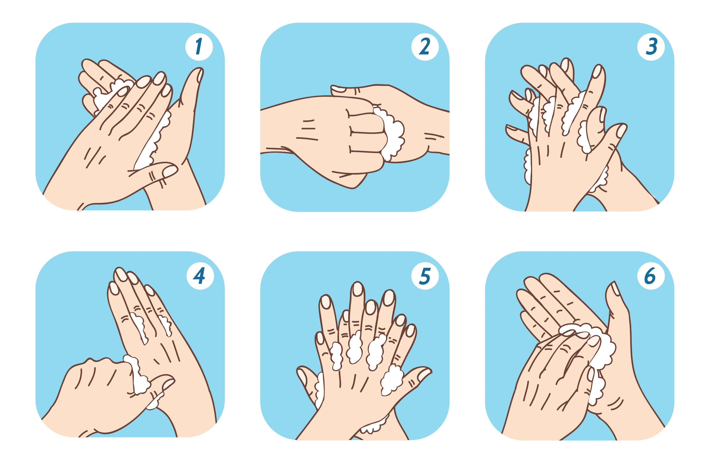
Standard precautions include:
Correct handwashing techniques
Handwashing involves using soap and water to clean the surface of the hands.
Wet hands under running water and apply soap.
Provide Support Services

Slide 210
Standard precautions include:
Correct handwashing techniques
Handwashing involves using soap and water to clean the surface of the hands.
Rub hands for 20 seconds and make sure that the soap and water reach all parts of the hand.
Rinse hands thoroughly with running water and dry with clean towels.
Provide Support Services

Slide 211

Standard precautions include:
Glove usage
This item is a type of Personal Protective Equipment (PPE) that covers the hands.
There are sterile, non-sterile and utility gloves.
When using gloves, you must:
Wash hands after removing gloves
Provide Support Services

Slide 212
Standard precautions include:
Glove usage
When using gloves, you must:
Change between clients or after each procedure
Wear gloves upon entering the client’s area and remove them before leaving the area
Only utility gloves can be reused
Provide Support Services

Slide 213
Standard precautions include:
Awareness of how infection is spread
The different ways infection can spread are:
Droplets in the air
Aerosols
Feces
Skin
Bodily fluids
Water and food
Pregnancy
Animals
Provide Support Services

Slide 214

Standard precautions include:
Managing the physical environment
Environmental cleaning is done in two ways:
Cleaning minimally touched surfaces
Cleaning frequently touched surfaces
Provide Support Services

Slide 215
Standard precautions include:
Respiratory hygiene
You can observe respiratory hygiene through the following ways:
Cover your mouth and nose when coughing and sneezing.
Use a tissue to contain respiratory secretions.
Dispose of tissues immediately in waste bins.
Practice hand hygiene.
Provide Support Services

Slide 216
Standard precautions include:
Respiratory hygiene
You can observe respiratory hygiene through the following ways:
If your hands are not clean or have not been washed, do not touch the mucous membranes of your mouth, eyes and nose.
In healthcare facilities, separate clients with known or suspected respiratory infections from other clients.
Provide Support Services

Slide 217
Standard precautions include:
Waste management
You can manage waste through the following ways:
Hand hygiene
Following your organisation’s waste management plan and segregation methods
Provide Support Services

Slide 218
Additional Precautions
Also known as ‘transmission-based precautions’
Used on top of standard precautions when standard ones are found insufficient
Usually used when a client is suspected or known to be infected with something.
Provide Support Services

Slide 219
Additional precautions include:
Contact precautions
Droplet precautions
These precautions are used to reduce infections transmitted via respiratory droplets.
This precaution is for clients known or suspected of having an infectious disease, especially a multi-resistant organism (MRO).
Airborne precautions
These are additional precautions that are used against infections transmitted via aerosols.
Provide Support Services

Slide 220

2.7 Seek Assistance From Supervisor as Necessary

Slide 221
You can refer to the following procedures when seeking assistance from your supervisor:
Identify what you need help with.
Politely ask for assistance.
Describe your issue clearly, briefly, and honestly.
Let your supervisor guide you.
Provide Support Services

Slide 222

What have we learnt?
In this part of the session, we have covered:
Determine personal support requirements
Provide support services
Monitor support activities
Complete reporting and documentation

Slide 223
End of Chapter 2

